Slide 1




Frontend Class - 3

Slide 2
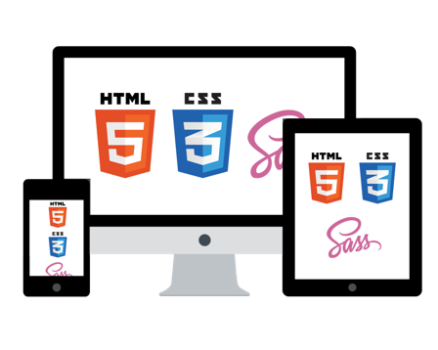


Slide 3
CSS … continued

Slide 4

CSS transition
Transitions allow you to change smoothly …
To create a transition effect, you must specify:
the CSS property you want to add an effect to
the duration of the effect
selector { transition: width 2s;
}

Slide 5
CSS transition
transition-timing-function:
ease - low start, then fast and end slowly (default)
linear - same speed from start to end
ease-in - slow start
ease-out - slow end
ease-in-out - slow start and end
cubic-bezier(n,n,n,n) - define your own values
https://codepen.io/wvegteren/pen/pozYbGK

Slide 6
CSS transform
Applies a 2D or 3D transformation to an element.
This allows you to rotate, scale, move, skew, …, elements.
selector { transform: rotate(20deg);
}
https://codepen.io/wvegteren/pen/oNvVzbx

Slide 7
CSS animation
Allows animation of HTML elements without using JavaScript
@keyframes rule - define the stages and styles of the animation
@keyframes example { from {background-color: red;} to {background-color: yellow;} }

Slide 8
CSS animation
Allows animation of HTML elements without using JavaScript
@keyframes rule - define the stages and styles of the animation
@keyframes example { 0% {background-color: red;} 30% {background-color: green;}
60% {background-color: blue;}
100% {background-color: yellow;}
}

Slide 9
CSS animation
To get an animation to work, you must bind the animation to an element
@keyframes example { from {background-color: red;} to {background-color: yellow;} } /* bind the animation to the element */ div { width: 100px; height: 100px; background-color: red; animation-name: example; animation-duration: 4s; }

Slide 10
CSS animation
animation-name - the name of the @keyframes animation
animation-duration - time the animation should take to complete one cycle
animation-timing-function - the speed curve of the animation
animation-delay - a delay for the start of an animation
animation-iteration-count - the number of times an animation should be played
animation-direction - should the animation be played forward, backward
or in alternate cycles
animation - shorthand property for setting all animation properties
https://codepen.io/wvegteren/pen/WNemRjj

Slide 11
BEM
Notes:
Processing order

Slide 12
BEM
Popular naming convention for writing cleaner and more readable CSS
Block, Element, Modifier

Slide 13
BEM-block
Blocks are independent, reusable and usually
bigger components of a webpage.
Common blocks: header, content, sidebar, footer, navigation, search …

Slide 14
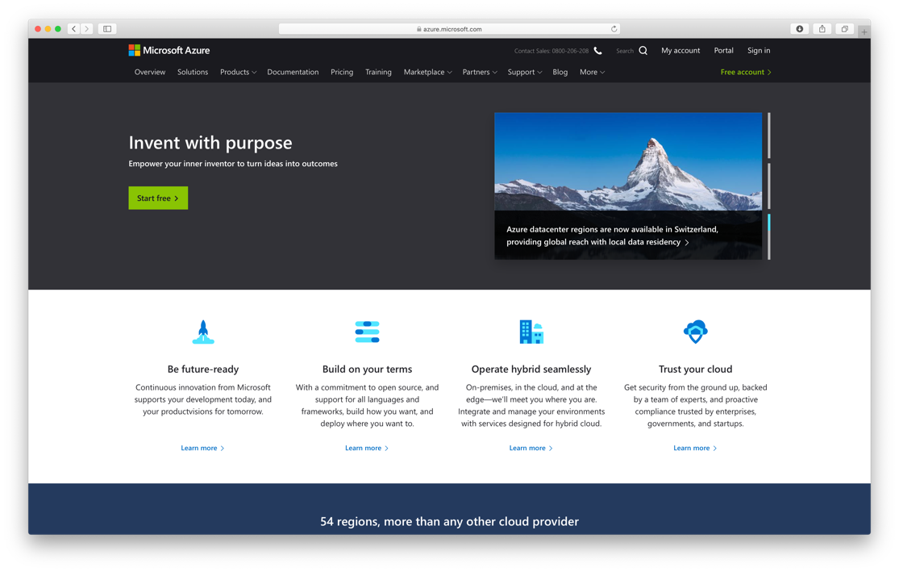
BEM-block

Slide 15
BEM-element
Elements are children of blocks
An element can only have 1 parent Block,
and can’t be used independently outside of that block.

Slide 16
BEM-element

Slide 17
BEM-modifier
Modifiers represent different states or styles of classes
Modifiers can be used both for blocks or elements
A modifier must be used together with its Block / Element as additional feature

Slide 18
BEM-modifier

Slide 19
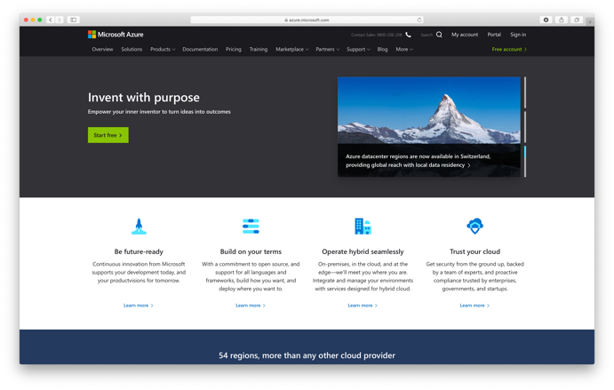
BEM
CSS selector:
.[block]__[element]--[modifier]
.usp {}

Slide 20
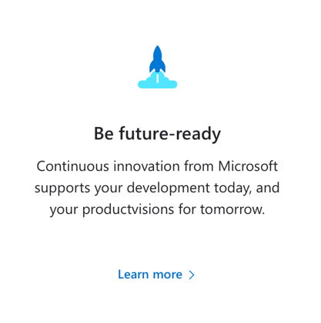
BEM
CSS selector:
.[block]__[element]--[modifier]
.usp {}
.usp__card {}
.usp__card--active {}
.usp__icon {}
.usp__title {}
.usp__tagline {}
.usp__link {}
.usp__link--active {}
.usp__link--active:hover {}

Slide 21
Notes:
Processing order

Slide 22

SASS
Syntactically Awesome Stylesheet
SASS is a CSS Pre-Processor
http://sass-lang.com/

Slide 23
SASS
SASS offers features that do not exist in CSS, like:
Variables * - ie color scheme
Nesting - follow the structure of your HTML
Partials - Import - separate styles in different files
Mixin - structures for reuse
Extend - share properties from selectors
Math operators - ie to calculate width, etc.
http://sass-lang.com/

Slide 24
SASS
Install
$ npm install sass -g
Run
$ sass --watch input.scss output.css
$ sass --watch app/sass:target/css

Slide 25
SASS - Variables
Variable can be any CSS value you want to reuse
The $ symbol turns something into a variable
scss
css
$font-stack: Arial, sans-serif; $primary-color: #333; body { font: 100% $font-stack; color: $primary-color; }
body { font: 100% Arial, sans-serif; color: #333; }

Slide 26
SASS - Nesting
SASS allows you to nest CSS selectors in a way that follows the same hierarchy of the HTML
html
... <nav> <ul> <li><a href="/">Home</a></li> <li><a href="/about">About</a></li> <li><a href="/archive">Archive</a></li> </ul> </nav> ...

Slide 27
SASS - Nesting
nav { ul { margin: 0; padding: 0; list-style: none; } li { display: inline-block; a { display: block; padding: 6px 12px; text-decoration: none; } } }
scss
css
nav ul { margin: 0; padding: 0; list-style: none; }
nav li { display: inline-block; }
nav li a { display: block; padding: 6px 12px; text-decoration: none; }

Slide 28
SASS - Partials
Partials are little snippets that you can include in other SASS files
Partials help to modularize the CSS … easier to maintain
A partial is a SCSS file named with a leading underscore
// _partial.scss
$primary-color: #333; html, body { margin: 0; padding: 0; }
scss

Slide 29
SASS - Import
@import directive allows to use partials in SASS files
// _partial.scss
$primary-color: #333; html, body { margin: 0; padding: 0; }
scss
css
html, body { margin: 0; padding: 0; }
body { font: 100% Arial; color: #333; }
// style.scss
@import "partial"; body { font: 100% Arial; color: $primary-color; }
scss

Slide 30
SASS - Mixin
Mixins lets you make groups of CSS declarations
that you can reuse throughout your application
Declare: @mixin <name> { }
Use: @Include <name> { }

Slide 31
SASS - Mixin
scss
css
@mixin border($color: $blue-dark){ border: 1px solid $color;
border-radius: 6px; }
.box { @include border(); } .box--danger { @include border(#d30d4e); }
.box { border: 1px solid #00006b; border-radius: 6px; } .box--danger { border: 1px solid #d30d4e; border-radius: 6px; }

Slide 32
SASS - Mixin
scss
css
@mixin border($color: $blue-dark){ border: 1px solid $color;
border-radius: 6px; }
.box { @include border(); &--danger { @include border(#d30d4e);
} }
.box { border: 1px solid #00006b; border-radius: 6px; } .box--danger { border: 1px solid #d30d4e; border-radius: 6px; }

Slide 33
SASS - Extend
@extend lets you share a set of CSS properties from one selector to another
scss
css
.button { border: none; padding: 15px 30px; text-align: center; cursor: pointer; } .button--submit { @extend .button; background-color: blue;
color: white; }
.button, .button--submit { border: none; padding: 15px 30px; text-align: center; cursor: pointer; } .button--submit { background-color: blue; color: white; }

Slide 34
SASS - Operators
SASS supports standard math operators like + - * / and %
scss
css
article { float: left; width: 600px / 960px * 100%; } aside { float: right; width: 300px / 960px * 100%; }
article { float: left; width: 62.5%; } aside { float: right; width: 31.25%; }

Slide 35

Responsive Design
Notes:
Processing order

Slide 36

Responsive Design
Use HTML and CSS to
resize, hide, shrink, enlarge or move content
to make it look good on any screen

Slide 37
Responsive Design
Recipe:
Set viewport
Use media queries
Use a grid-view
Optimize for mobile use

Slide 38
Responsive Design
Viewport - the user's visible area
<meta name="viewport" content="width=device-width, initial-scale=1" />
<meta name="viewport"
content="width=device-width, minimumscale=1, maximum-scale=2" />
<meta name="viewport"
content="width=device-width, initial-scale=1, user-scalable = no" />

Slide 39
Responsive Design
Media Queries
@media rule - include CSS properties if a certain condition is true.
Media Queries - react on:
screen size
orientation
resolution

Slide 40
Responsive Design
CSS Media Queries
@media screen
and (min-width: 500px)
and (max-width: 1023px) { … }
@media screen and (orientation: landscape) { … }
<meta name="viewport" content="width=device-width, initial-scale=1" />

Slide 41
Responsive Design
CSS Media Queries
@media screen
and (min-width: 500px)
and (max-width: 1023px) { … }
@media screen and (orientation: landscape) { … }
<meta name="viewport" content="width=device-width, initial-scale=1" />
Media Type - screen, print, speech, all

Slide 42
Responsive Design
CSS Media Queries
@media screen
and (min-width: 500px)
and (max-width: 1023px) { … }
@media screen and (orientation: landscape) { … }
<meta name="viewport" content="width=device-width, initial-scale=1" />
Media Feature – width, height, resolution, prefers-reduced-motion, …

Slide 43
Responsive Design
Media in HTML
<link href="phone.css"
media="only screen and (max-width: 499px)"> <link href="tablet.css"
media="only screen
and (min-width: 500px)
and (max-width: 1023px)"> <link href="desktop.css"
media="only screen and (min-width: 1024px)">

Slide 44
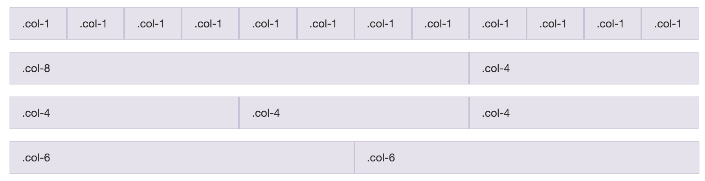
Responsive Design
Grid View
divides page into columns

Slide 45
Responsive Design
Grid View

Slide 46
Responsive Design
Optimize for mobile use
Select appropriate keyboard
see slides class 1

Slide 47
Responsive Design
https://www.w3schools.com/css/tryit.asp?filename=tryresponsive_col-s

Slide 48
Questions ?

Slide 49
Assignment
Create a responsive contact form with fields for:
name
date of birth
gender
phone
email
…
Give the form some nice BEM styling

